Slide 1

REAL-TIME ACCIDENT MONITORING SYSTEM USING IoT
By
Batch-2105
M Gowthami 214G1A0430
K Govardhan Reddy 214G1A0428
N Ambika 214G1A0404
B Deepak 214G1A0419
Under the esteemed guidance of
Dr. K Dada Sikandar, M . Tech., Ph.D.
Associate Professor, ECE Dept.,
Srinivasa Ramanujan Institute of Technology (AUTONOMUS)
Anantapur

Slide 2
CONTENTS
Abstract
Objective
Introduction
Literature Survey
Existing System
Proposed System
Advantages
Results
Future Scope
Conclusion
References

Slide 3
ABSTRACT
The main aim of this project is to develop an accident monitoring system that can be installed in any vehicle.
In the event of an accident, the system automatically triggers an alert via GSM, notifying emergency services and designated contacts.
And also, this system checks whether the driver is drunken, if driver consumed alcohol then the system stops the engine so that accidents due to alcohol consumption is reduced.
Simultaneously, it uploads detailed incident data to the cloud platform ThingSpeak, where it can be accessed for comprehensive analysis.

Slide 4
OBJECTIVE
The main objective of this project is to design and implement an accident monitoring, detection and alert system that enhances vehicle safety by leveraging modern technology.
The objectives are:
Real-Time Monitoring
Immediate Alerts
Data Recording
Prevention and analysis of an accident
The system detects alcohol and automatically stops the engine to prevent drunk driving

Slide 5
INTRODUCTION
Road accidents result in approximately 1.3 million deaths and 20–50 million injuries worldwide each year.
These accidents lead to significant economic losses, amounting to about 3% of a nation's GDP, alongside high medical expenses, lost productivity, and emotional distress.
The proposed Accident Analysis and Alert System aims to improve vehicle safety using advanced sensors and communication technologies.
The system detects hazards such as fire, impact vibrations, alcohol consumption by the driver, and vehicle tilts or rollovers in real-time.
On detecting an anomaly, it sends immediate SMS alerts with GPS coordinates to registered contacts, ensuring quick responses and enhanced safety.

Slide 6
LITERATURE REVIEW
Authors | Title | Summary
Ibrahim et al. [1] | Black-box Accident Detection and Location System Using Raspberry Pi, GPS, and GSM Technologies | This system detects accidents using multiple sensors, determines accident location via GPS, and transmits essential accident data (time, speed, coordinates) via GSM to emergency services. It is a cost-effective alternative to traditional systems and functions independently of vehicle age and smartphone availability. The system can detect collisions. Drawback: It does not detect the alcohol and stop the engine.

Slide 7
Authors | Title | Summary
Manish et al. [2] | Car Black Box | An Android-based system that captures data like video footage, speed, and location. It uploads data to the cloud, alerts emergency contacts, and offers navigation and anti-theft features. Drawback: This only stores the data.
Mahziar et al. [3] | IoT-Based Vehicular Accident Detection Systems | The work discusses using IoT technologies (e.g., sensors, cloud computing) for real-time accident detection and emergency response, aiming to improve response times and reduce fatalities.

Slide 8
EXISTING SYSTEM
In normal accident monitoring systems, reporting and detection of an accident depend mostly on human.
This type of manual reporting is done when the people see the accident otherwise reporting to emergency services will be very much delayed. This process leads to significant delays in response time, which can be critical in life threatening situations.
Limited use of advanced sensors and technologies to proactively detect potential risks such as fire, driver intoxication, or vehicle instability.

Slide 9
PROPOSED SYSTEM
The proposed system aims to enhance road safety by detecting potential accident scenarios, alerting concerned individuals in real-time, and storing critical data for post-accident analysis. It uses advanced sensor integration, real-time communication, and data storage capabilities.
The system prevents drunk driving and enhances vehicle safety using an MQ-3 alcohol sensor, Arduino UNO, and L293D motor driver to cut engine power if alcohol is detected. An LCD display shows warnings, while the GSM module sends alerts.
Real-Time Monitoring: Continuously monitor vehicle parameters like speed, vibration, fire, alcohol levels, and tilt angle.
Instant Alerts: Notify the vehicle owner or registered contacts via SMS with GPS coordinates in case of abnormal events.
Data Logging: Store all sensor data during abnormal activities to facilitate post-accident investigation and analysis.

Slide 10
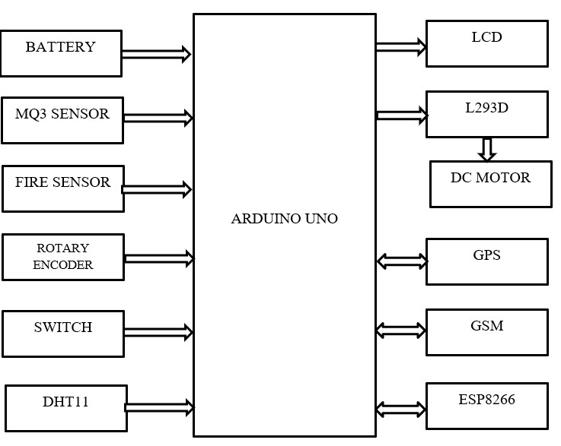
Block Diagram

Slide 11
Hardware used :
Arduino UNO – Central microcontroller for processing and control.
Battery – Power source for the system.
LCD (Liquid Crystal Display) – For displaying real-time information and status.
Fire Sensor – Detects smoke or fire in the vehicle.
Gas Sensor – Detects harmful gases (e.g., alcohol, carbon monoxide).
DHT11 – Temperature and humidity sensor.
MPU6050 – Accelerometer and gyroscope for detecting sudden motion or accident.
Slide Switch – Used for manually turning the system on or off.
GSM Module – Sends SMS alerts in case of emergencies.
DC Motors – Used for mechanical responses, such as unlocking doors.
L293D Motor Driver – Controls the DC motors.
ESP8266 – Wi-Fi module for remote monitoring and data transmission to the cloud.
Rotary Encoder – Measures rotational position and movement

Slide 12
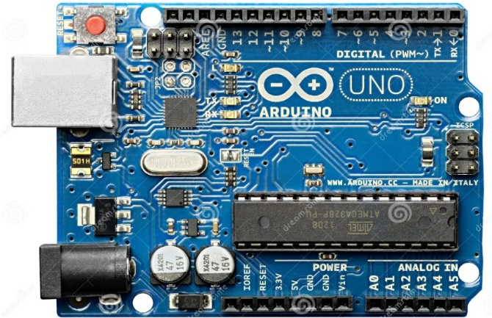
Arduino Uno
Arduino UNO is a frequently used open-source microcontroller board developed mainly on the Microchip ATmega328P processor developed by Arduino.cc. Equipped with several digital and analog input/output needles (E/A) that allow for seamless integration with expansion modules (signs) and external circuits. The card includes 14 digital E/A pencils and six analog input needles that allow for a versatile interface. Programming is facilitated by the Arduino Integrated Development Environment (IDE) using a Type B USB connection

Slide 13
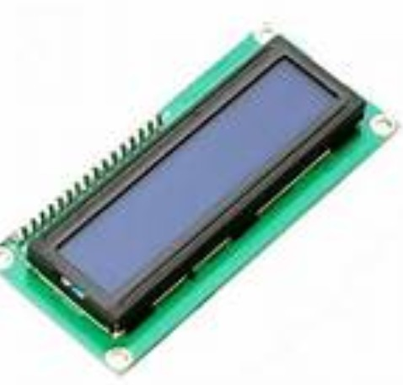
LCD (Liquid Cristal Display)
A thin, flat display device called a liquid crystal display (LCD) is composed of an arbitrary number of color or monochrome pixels arranged in front of a reflector or light source. Each pixel is made up of two polarizing filters with axes of polarity perpendicular to one another and a column of liquid crystal molecules suspended between two transparent electrodes. Light flowing through one would be obstructed by the other if there were no liquid crystals between them. Light entering one filter is allowed to pass through the other by the liquid crystal's twisting of its polarization.

Slide 14
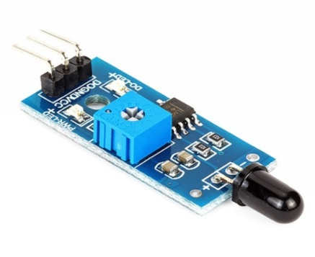
FIRE sensor
One type of detector that is primarily intended for identifying and reacting to the presence of a fire or flame is a flame sensor. Its fitment may affect the flame detection reaction. It has a fire suppression system, propane, a natural gas connection, and an alarm system. Boilers used in industry employ this sensor. This serves the primary purpose of verifying whether or not the boiler is operating correctly. Compared to a heat/smoke detector, these sensors respond more quickly and accurately due to their mechanism for detecting flames

Slide 15
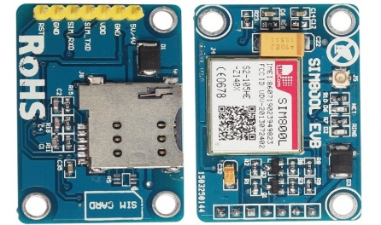
GSM (Global System for Mobile communications)
Since the Global System for Mobile Communications (GSM) is a cellular network, cell phones connect to it by looking for nearby cells. There are four distinct frequency ranges in which GSM networks function. Short message service (SMS, sometimes known as "text messaging"), which is now supported by various mobile protocols, was another low-cost alternative to voice calls that GSM invented. The standard's inclusion of the one global emergency phone number, 112, provides an additional benefit. Without knowing the local emergency number, this makes it simpler for foreign visitors to contact emergency services.

Slide 16
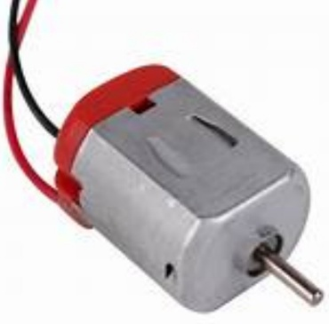
dc motor
A DC motor is designed to run on DC electric power. Two examples of pure DC designs are Michael Faraday's homopolar motor (which is uncommon), and the ball-bearing motor, which is (so far) a novelty. By far, the most common DC motor types are the brushed and brushless types, which use internal and external commutation to create an oscillating AC from the DC source- so they are not purely DC machines in a strict sense.

Slide 17
Softwares Used:
Embedded C
Arduino IDE
ThingSpeak cloud platform

Slide 18
Operation:
The car gets started only when the person who drives has not consumed the alcohol.
These sensors are connected to the Arduino UNO, which processes the data and triggers responses, such as sending alerts via the GSM module or displaying data on the LCD. The L293D motor driver controls DC motors for emergency responses, like unlocking doors, and the slide switch allows manual system control. The system is programmed to monitor real-time data, process the input, and activate safety mechanisms like SMS alerts during an emergency, while the ESP8266 facilitates remote monitoring via the internet.

Slide 19
ADVANTAGES
Alerts police and medical units about accidents.
Simple design and can be interfaced with other systems.
Easy to operate by the user.
Reliable system.
Easy to take action immediately.

Slide 20
Applications
Prevents drunk driving by stopping the vehicle if the driver is under the influence of alcohol.
▪ Improves road safety by reducing the chances of accidents caused by impaired driving.
▪ Sends emergency alerts with GPS location to a contact person when a crash happens.
▪ Helps emergency teams find the accident spot quickly and provide fast help.
▪ Detects vehicle fires and sends the vehicle’s location to fire services for quick action.
▪ Stores all data (like alcohol level, accidents, fire, GPS info) on the Thingspeak IoT platform .
▪ Allows accident analysis on Thingspeak, which can help understand causes and patterns of accidents

Slide 21
RESULTS
The system is designed to enhance road safety by preventing drunk driving and facilitating emergency response in the event of an accident or fire. To accomplish this, the system includes an automated mechanism that disables vehicle operation when the driver is detected to be under the influence of alcohol. This proactive measure helps prevent impaired individuals from driving, thereby reducing the risk of accidents. In the case of a collision, the system automatically sends the vehicle’s GPS location to a designated emergency contact.

Slide 22
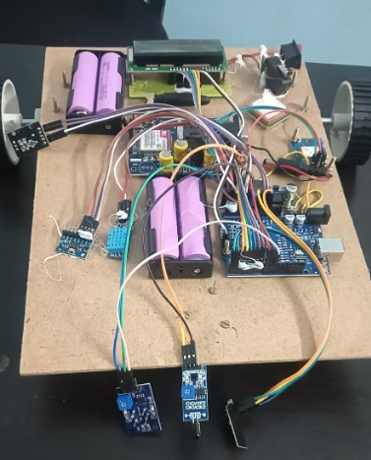
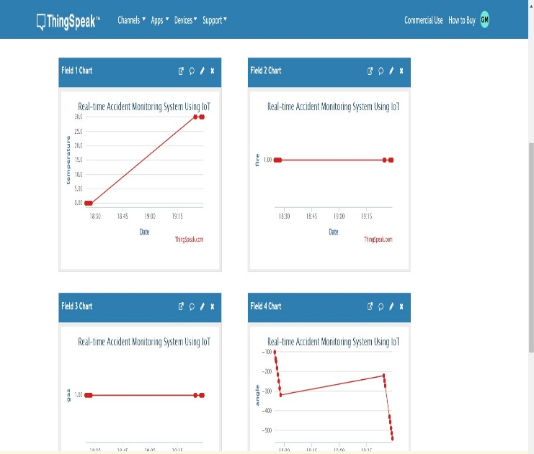
Fig: Hardware Setup
Fig: Thingspeak Output

Slide 23
Output explanation
The image displays a dashboard from ThingSpeak showing real-time data visualizations for an IoT-based accident monitoring system. There are four separate field charts, each representing different sensor readings: temperature, fire detection, gas level, and angle. These parameters are crucial for detecting potential accidents or hazardous events. The temperature chart shows a significant increase, indicating a possible rise in environmental heat. The fire and gas readings appear constant, while the angle chart shows fluctuations that could suggest a tilt or impact—useful for detecting vehicle accidents. Together, these graphs demonstrate how IoT can be utilized for continuous monitoring and quickresponse in accident scenarios.

Slide 24
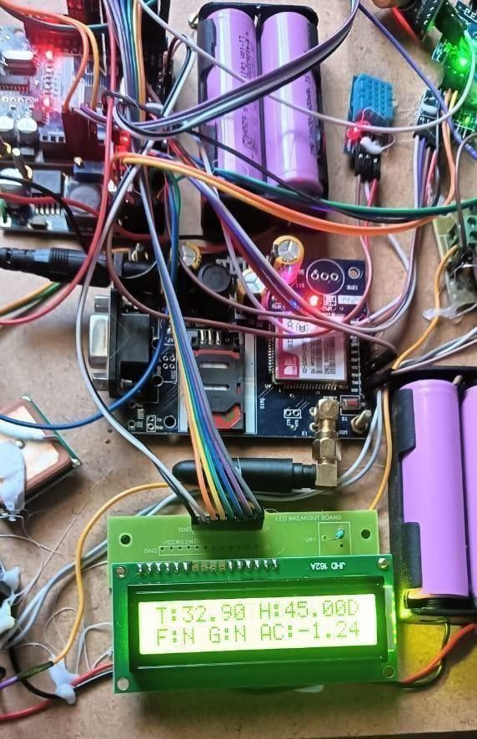
Output in LCD
There's an Arduino microcontroller connected to a GSM module, a GPS module, sensors (such as a temperature and humidity sensor), and a display. The LCD screen is actively displaying real-time data including temperature (T: 32.90°C), humidity (H: 45.00%), fire detection (F: N), gas detection (G: N), and acceleration (AC: 1.24), indicating the system is functioning and collecting live environmental and motion data. Powered by rechargeable batteries, this compact setup is designed for use in smart safety systems—especially for vehicle accident detection and alerting—by collecting critical parameters and transmitting them remotely via GSM.

Slide 25
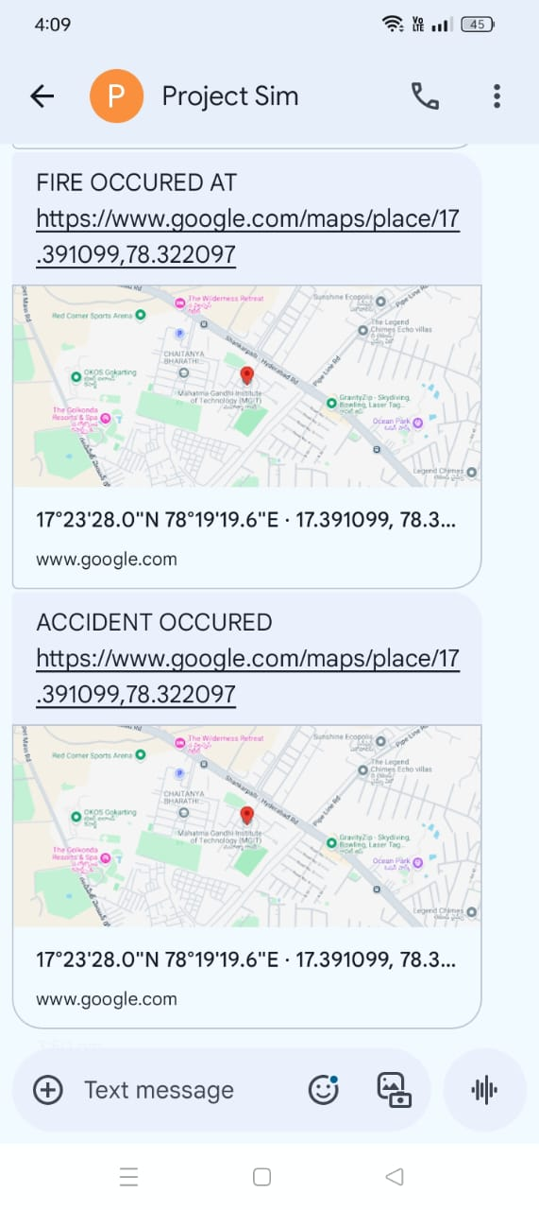
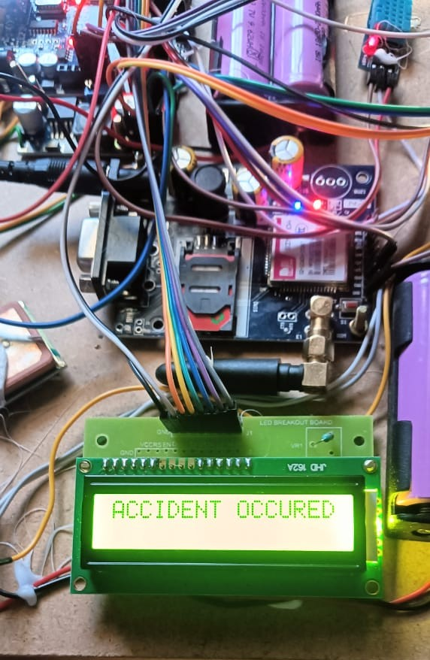
Fig: Message
Fig: LCD Output

Slide 26
FUTURE SCOPE
The future scope includes enhancing the system with AI for real-time risk prediction and proactive accident prevention. It can integrate with advanced communication networks like 5G for faster data transmission and provide cloud storage for detailed accident analysis.
Additionally, expanding its compatibility with autonomous vehicles and making it affordable .

Slide 27
Conclusion
The proposed system significantly enhances road safety by integrating automatic vehicle shutdown upon detecting driver intoxication, real-time GPS location transmission during collisions, and fire detection alerts. These features collectively aim to reduce drunk driving incidents, improve emergency response times, and minimize accident casualties.
Also, it shows the output in thingspeak platform in the form of graphs.

Slide 28
REFERENCES
Ibrahim Kadri, Boufeldja Kadri, Mohamed Beladgham, and Dahmane Oussama Department of Electrical Engineering, Tahri Shobitha, Anvitha Muthamma K. C, 2021, Black Box for Automobiles, International Journal Of Engineering Research & Technology (IJERT) NCCDS – 2021 (Volume 09-Issue 12)
Garcia-Barrientos, A.; Torres-Uresti, D.; Castillo-Soria, F.R.; PinedaRico, U.; Hoyo-Montaño, J.A.; Perez-Cortes, O.; OrdazOliver, P. Design and Implementation of a Car’s Black Box System Using a Raspberry Pi and a 4G Module. Appl. Sci. 2022, 12, 5730.
M. Karrouchi, I. Nasri, H. Snoussi, I. Atmane, A. Messaoudi and K. Kassmi, "Black box system for car/driver monitoring to decrease the reasons of road crashes," 2021 4th International Symposium on Advanced Electrical and Communication Technologies (ISAECT), Alkhobar, Saudi Arabia, 2021, pp. 01-06, doi: 10.1109/ISAECT53699.2021.9668545.

Slide 29
4. Md. Shaad Mahmud, Honggang Wang, A.M.Esfar-E-Alam and Hua Fang has focused on “A Wireless Health Monitoring System Using Mobile Phone Accessories”, Proc-IEEE, vol.1, no.99, pp-2327-4662 2016
5. Sarika R. Gujar and Prof. A. R. Itkikar have focused on “Advanced Embedded System of Vehicle Accident Detection and Tracking System”, Proc-IEEE, vol.5, no.2, pp- 2277 128X 2015
6. Zaobo He, Zhipeng Cai, Jiguo Yu, Xiaoming Wang, Yunchuan Sun, and Yingshu Li, has discussed on “Cost-Efficient Strategies for Restraining Rumor Spreading in Mobile Social Networks”, Proc-IEEE, vol.66, no.3 2017
7. Hyung-Sin Kim, Hongchan Kim, Jeongyeuo Paek, and Saewoong Bahk have discussed on “Load Balancing Under Heavy Traffic in RPL Routing Protocol for Low Power and Lossy Networks”, Proc-IEEE, vol. 16, no.4, pp. 1536-1233 2017

Slide 30


